Slide 1
Measuring priming with motion capture
Khen Heller
Notes:
My experiment’s goal is to show that trajectory analysis can be used to identify unconscious processing effects, and specifically semantic priming.

Slide 2
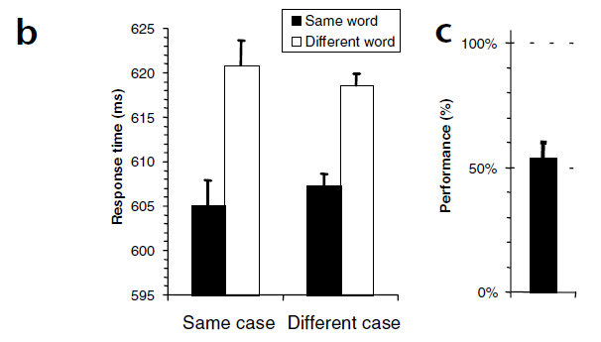
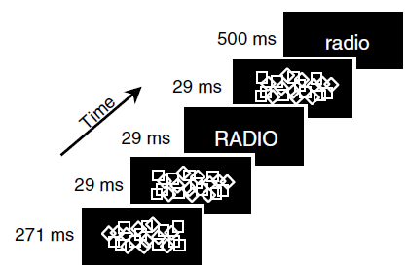
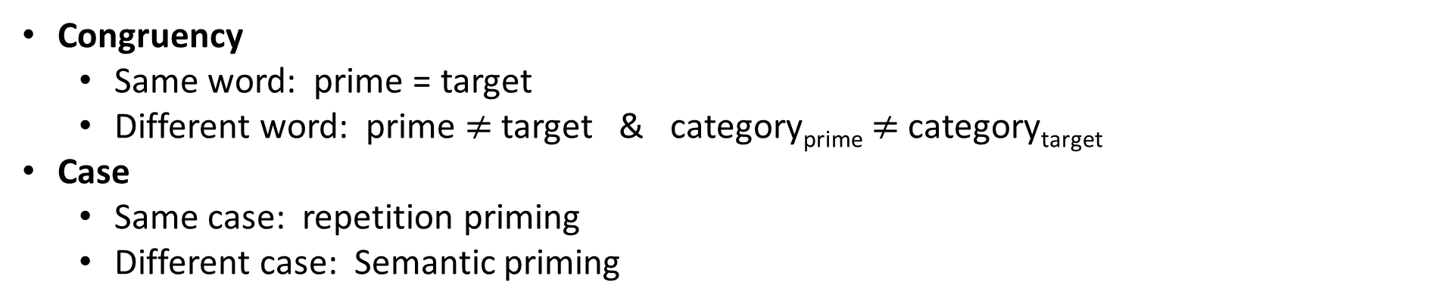
Dehane et al., 2001
Congruency
Same word: prime = target
Different word: prime $≠$ target & category_{prime} $≠$ category_{target}
Case
Same case: repetition priming
Different case: Semantic priming
Forced choice
Dehaene et al., (2001). Cerebral mechanisms of word masking and unconscious repetition priming. Nature neuroscience, 4(7), 752-758.
Notes:
The experiment relies on Dehaene’s paper from 2001.
Where he displayed a masked prime and a target to subjects.
The prime and target were words describing natural / artificial items, and subjects were asked to categorize the target accordingly.
For example, when the target was “radio” they chose “artificial”.
Congruency was manipulated in the experiments such that:
On same word trials the prime and the target were identical,
On different word trials the prime and the target were different words from different category.
The letter case of the target and the prime was also manipulated which allowed to check repetition priming on the same case condition
And semantic priming on the different case condition.
Results:
When we check the response times we can see:
A repetition priming effect (15ms) since RT was quicker when the prime was identical to the target.
A semantic priming effect (12ms) since RT was quicker when the prime and target where the same word but in different font.
______________________________________________________________________________________________
At the end of the experiment subjects performed a force choice recognition task: in which they had to recognize the prime between 2 displayed words.
Forced choice showed that subjects weren’t aware of the prime.
N = 10
40 stimuli words, half nat half art.
Forced choice after priming.
In exp 1:
~~~~~In task 1 they performed a naming task (name prime, if didn’t see specifically what is it, say “seen”)~~~~~
They ran recognition trials before and after imaging but not during. Same for exp 2.
Subjects need to recognize the prime, if saw only something they say “seen”

Slide 3
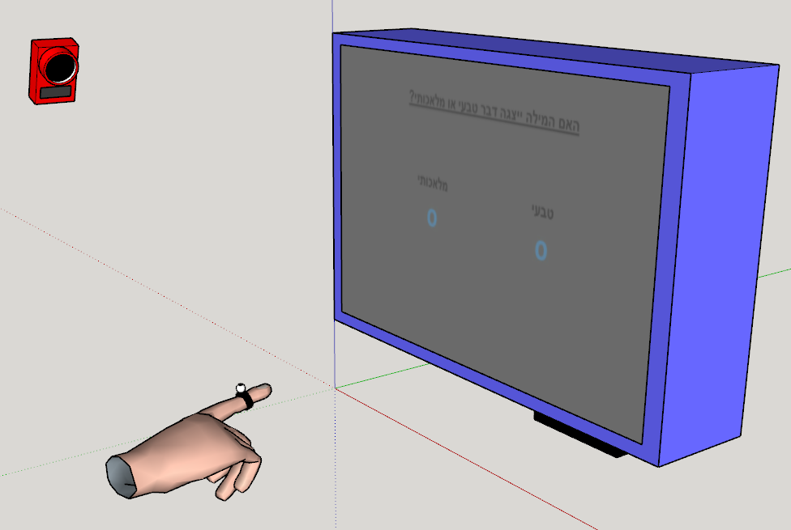
Prime-target relation: Same word
Fixation 1000ms
Mask 270ms
Mask 30ms
צינור
Prime 30ms
Mask 30ms
Time
צינור
Target 500ms
Man-made Natural
Categorization
צינור רובוט
Recognition
How well did you see the first stimuli?
On a scale of 1-4
PAS
1 2 3 4
Notes:
In our experiment we wish to replicate these results.
Only this time the subject is asked to answer by touching the appropriate answer on the screen.
In addition, our subjects perform the prime recognition task immediately after categorizing the target.
And lastly the subject answers a PAS.
Since we are only interested in semantic priming, primes are always displayed in handwriting while targets are always displayed in type script..
~~~~~~~~~~~~~~~~~~~~~~~~~~~~~~~~~~~~~~~~~
This experiment shows lexical activation? Not semantic.

Slide 4
Prime-target relation: Different word
Fixation 1000ms
Mask 270ms
Mask 30ms
אריות
Prime 30ms
Mask 30ms
Time
צינור
Target 500ms
Man-made Natural
Categorization
אריות גייזר
Recognition
How well did you see the first stimuli?
On a scale of 1-4
PAS
1 2 3 4
Notes:
This experiment shows lexical activation? Not semantic.

Slide 5
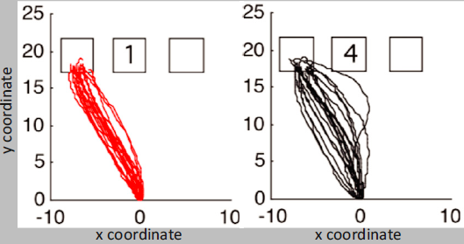
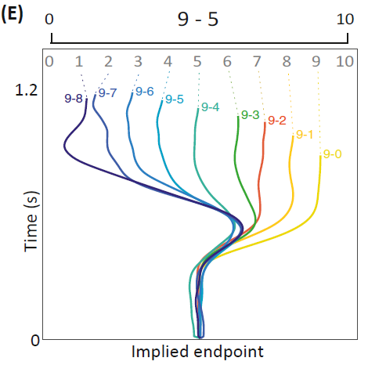
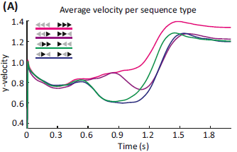
Wished results
Trajectory variance
Implied endpoint
Movement speed – measure confidence in answer
T-test between same points in time
Dotan, D., Pinheiro-Chagas, P., Al Roumi, F., & Dehaene, S. (2019). Track it to crack it: Dissecting processing stages with finger tracking. Trends in cognitive sciences, 23(12), 1058-1070.
Notes:
To find our effect we would compare the following parameters between congruent and incongruent trials:

Slide 6
Setup

Slide 7
Current work
Coded the experiment.
Integrated motion capture to experiment.
Written testing scripts.
Ran photodiode tests.
Open question: timings.

